Slide 1
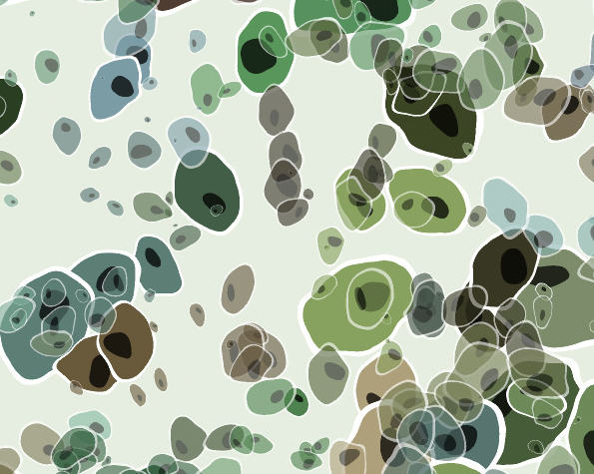
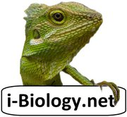
Cell
Theory
Stephen Taylor
i-Biology.net
Image: Cells by Filter Forge on Flickr http://flic.kr/p/ePXpR5

Slide 2
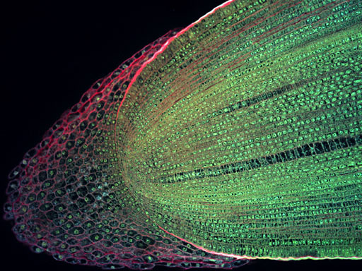
All living things are made of
C
E
L
L
S
Longitudinal section of a root tip of Maize (Zea mays)
by Science and Plants for Schools on Flickr (CC) http://flic.kr/p/bNNM6M

Slide 3
All living things are made of
C
E
L
L
S
Unicellular organisms are single-celled and can carry out all of the functions of life independently.
Multicellular organisms have specialized cells to carry out specific functions.
Longitudinal section of a root tip of Maize (Zea mays)
by Science and Plants for Schools on Flickr (CC) http://flic.kr/p/bNNM6M

Slide 4
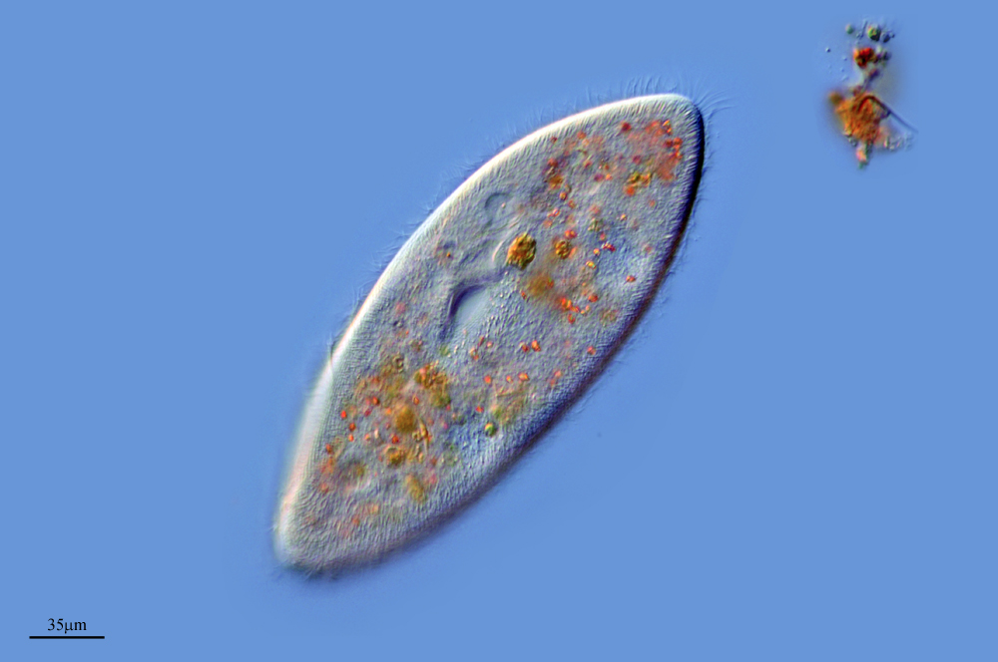
C
E
L
L
S
are the smallest
units of
life.
Paramecium multimicronucleatum
by Proyecto Agua on Flickr (CC) http://flic.kr/p/7W7J3y

Slide 5
C
E
L
L
S
are the smallest
units of
life.
Specialized
structures within
cells (organelles) carry out different functions.
Organelles cannot survive alone.
Paramecium multimicronucleatum
by Proyecto Agua on Flickr (CC) http://flic.kr/p/7W7J3y

Slide 6
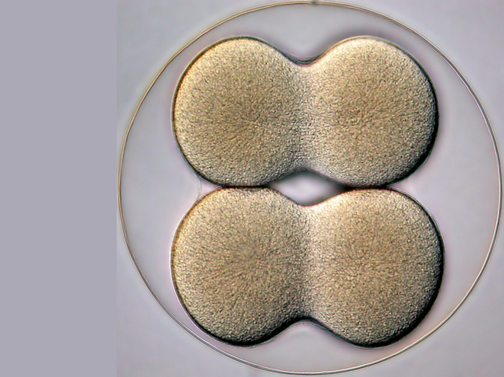
C
E
L
L
S
come
only
from
existing
cells.
4-cell stage of a sea biscuit by Bruno Vellutini on Flickr (CC) http://flic.kr/p/daWnnS

Slide 7
C
E
L
L
S
Cells multiply through division.
All life evolved from simpler ancestors.
Mitosis results in genetically identical diploid daughter cells.
Meiosis generates haploid gametes (sex cells).
Pasteur disproved the theory of spontaneous generation with his experiments.
come
only
from
existing
cells.
4-cell stage of a sea biscuit by Bruno Vellutini on Flickr (CC) http://flic.kr/p/daWnnS

Slide 9
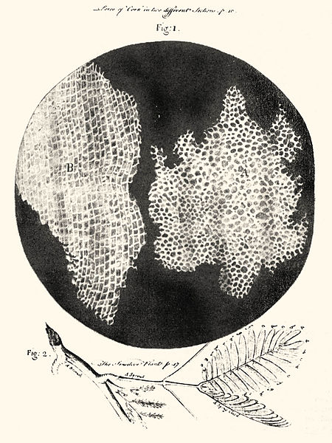
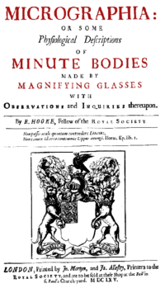
1665
Hooke names “cells” in his book
“Micrographia” after observing
cork under a lense.
All living things are made of cells.
Hooke’s Micrographia in full! http://lhldigital.lindahall.org/cdm/ref/collection/nat_hist/id/0

Slide 10
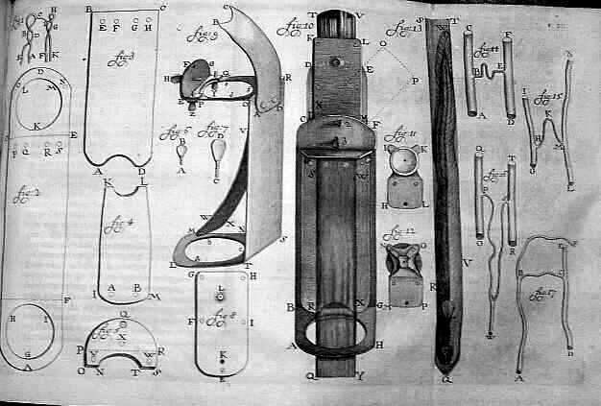
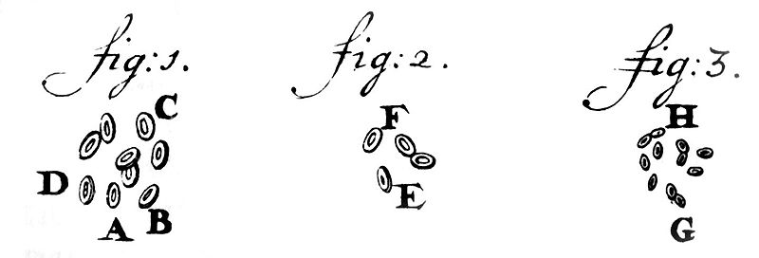
1676
van Leeuwenhoek, a master microscope maker identifies “animalcules” and becomes the father of microbiology.
All living things are made of cells.
http://en.wikipedia.org/wiki/Antonie_van_Leeuwenhoek

Slide 11
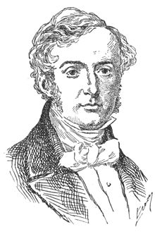
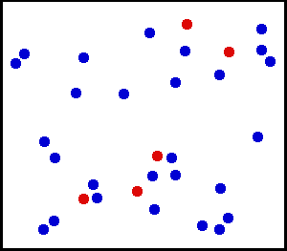
1833
Robert Brown names the cell nucleus.
Cells are the smallest units of life.
He also discovered Brownian motion:
Robert Brown: http://en.wikipedia.org/wiki/Robert_Brown_(botanist)
http://en.wikipedia.org/wiki/Brownian_motion

Slide 12
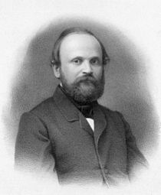
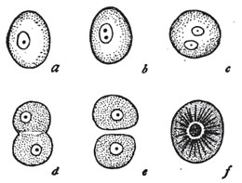
1855
Robert Remak discovers cell division and confirms the existence of the plasma membrane. Cells come only from pre-existing cells.
Robert Remak: http://en.wikipedia.org/wiki/Robert_Remak

Slide 13
1864
Pasteur disproves the prevailing theory of “spontaneous generation” with his swan-neck flask experiments.
Populations need to be seeded by existing populations: cells come only from pre-existing cells.
Image from Amoeba Mike’s Blog (go read the original post): http://amoebamike.wordpress.com/2009/10/06/spontaneous-generation-a-brief-history-of-disproving-it

